Slide 1
El Relicario
España
Costa Rica

Slide 2
En España

Slide 3
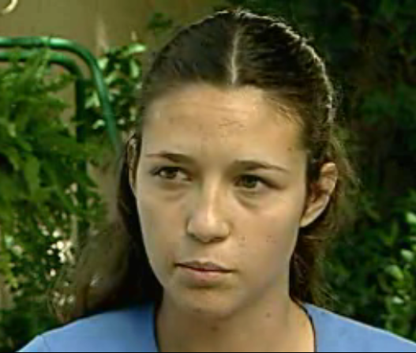

Slide 4
Victoria

Slide 6
Tía Candela

Slide 7
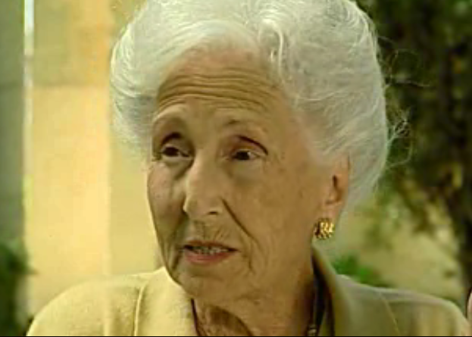

Slide 8
Consuelo

Slide 9
En Costa Rica

Slide 10
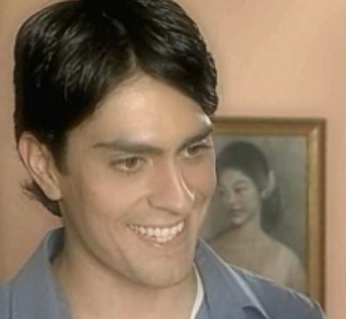

Slide 11
Alberto Gallegos (when he was young)

Slide 12
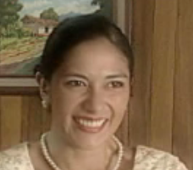

Slide 13
Graciela (when she was young)

Slide 14
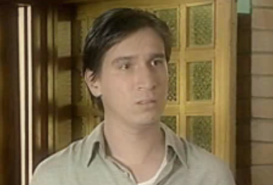

Slide 15
Jorge Calderón (when he was young)

Slide 16
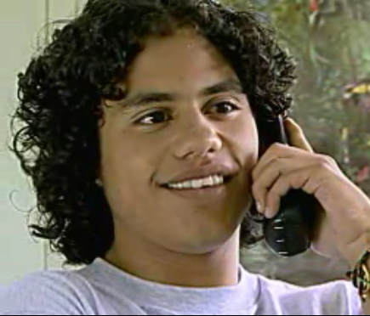

Slide 17
young Jorge Calderón

Slide 18
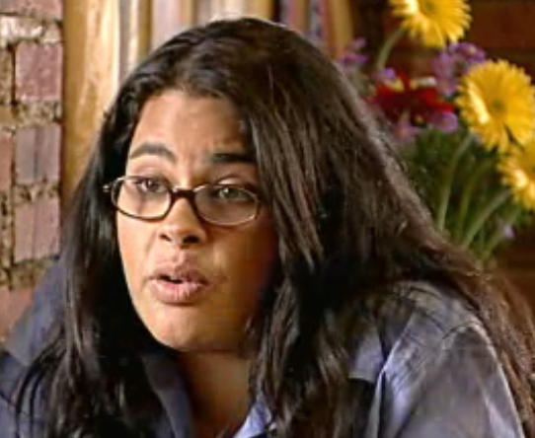

Slide 19
Diana Álvarez

Slide 20
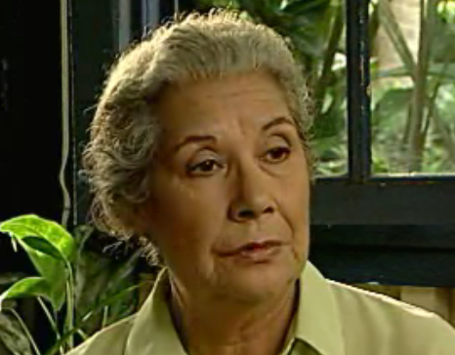

Slide 21
Sonia

Slide 22
OTHER
España
Costa Rica

Slide 23
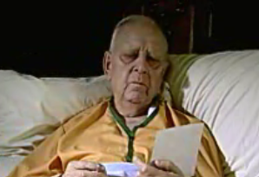

Slide 24
Alberto Gallegos (as an old man)

Slide 25
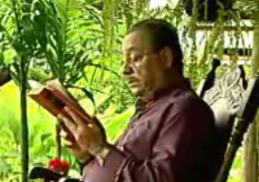

Slide 26
old man on porch

